Slide 1
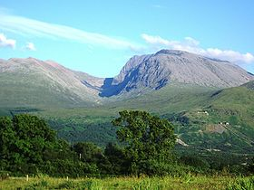
东岳 泰山 泰山位于山东省 五岳独尊
Ben Nevis
Ben Nevis is the highest mountain in the British Isles, is located in the Scottish Highlands, close to
Fort William.
One of the Highest mountains in China,
Is located in Shangdong province

Slide 2
中国 mountains vs Scottish mountains
1. What is a Munroe?
A Munro is a mountain in Scotland with a height over 3,000 ft.
They are named after Sir Hugh Munro, 4th Baronet (1856–1919), who produced the first list of such hills, known as Munros Tables, in 1891.
2. Any different features? What materials are there in Scottish mountains and Chinese mountains?
Peat is found in bogs and used as fertilizer or fuel.
The Chinese character for mountain/s is :山 (shan). Two thirds of China (中国 ) is made up of mountains.
3. Do Chinese people do anything such as munro-bagging?
Mountains are considered a sacred place for Chinese people. Traditionally, Chinese people don’t climb mountains “for fun” because they respect mountains and they think mountains are holy places.
What is another word for “holy”?

Slide 3
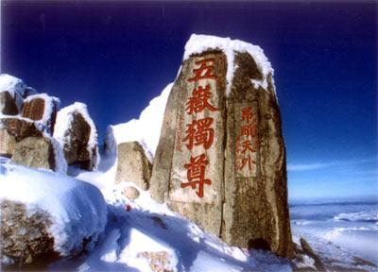
东岳泰山 Mount Tai
The Tai Mountain lies in central Shandong Province, formed 100,000,000 million years ago. It was considered to be the most important amongst China's Five Sacred Mountains and served as a ceremonial centre in China.

Slide 6
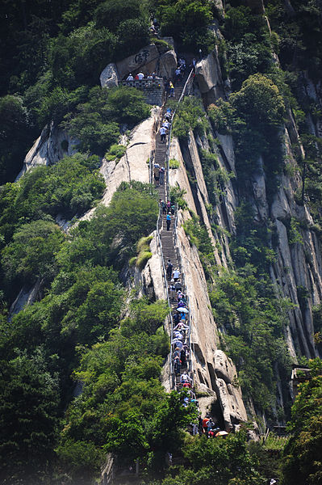
西岳 华山
Huan Shan -the most dangerous mountain in China, it is located in Shan’Xi province, also known as Xiyuè, Western Great Mountain. Originally classified as having three peaks, in modern times the mountain is classified as five main peaks, of which the highest is the South Peak at 2154.9m.

Slide 7
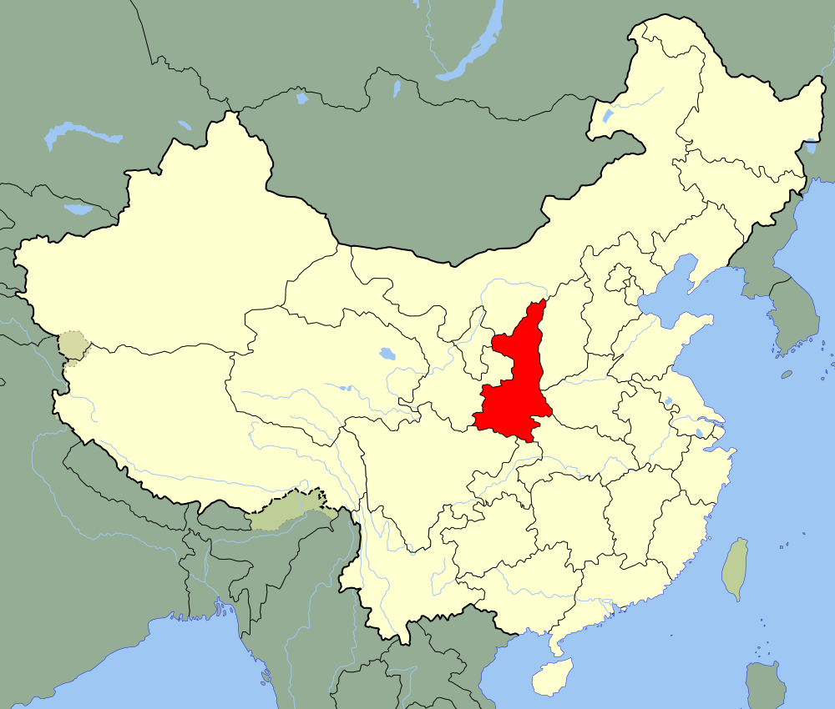

Slide 8
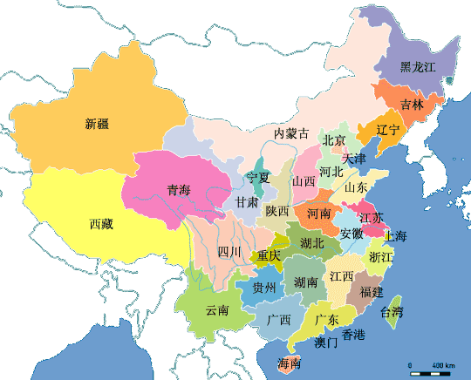

Slide 9
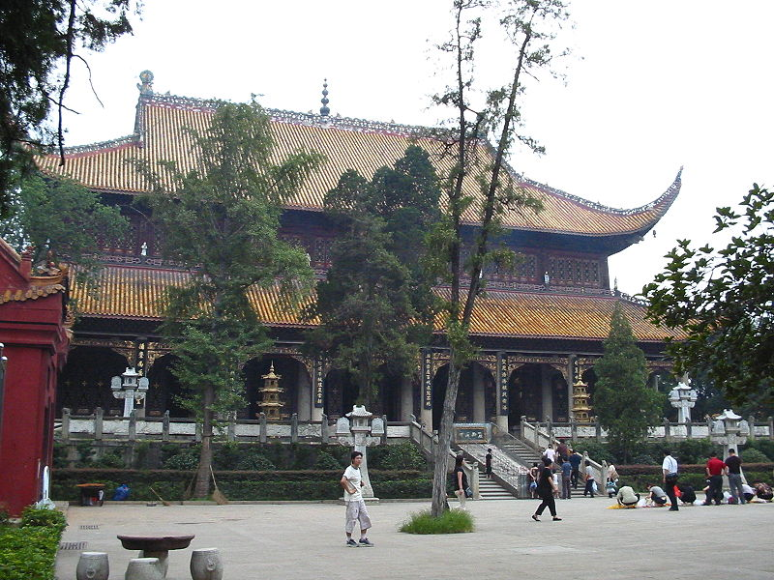
南岳 衡山
Heng Shan is a mountain range 150 kilometres (93 miles) long with 72 peaks, which is located in Hu’nan province. At the foot of the mountain stands the largest temple in southern China, the Grand Temple of Mount Heng (Nanyue Damiao), which is the largest group of ancient buildings in Hunan Province. Heng Shan is regarded as the most beautiful mont among the five.

Slide 12
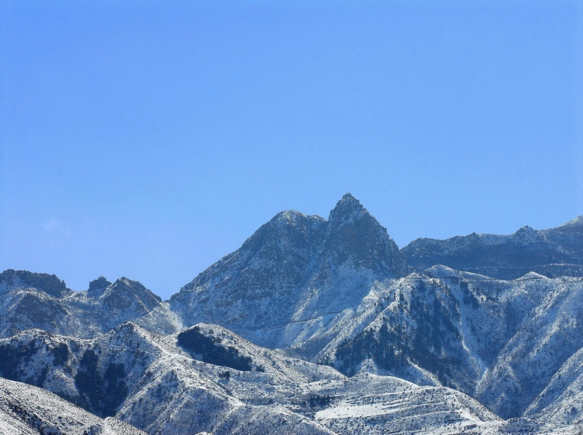
北岳 恒山
Heng Shan, which is located in Shanxi province, has been considered a sacred mountain since the Zhou Dynasty.

Slide 15
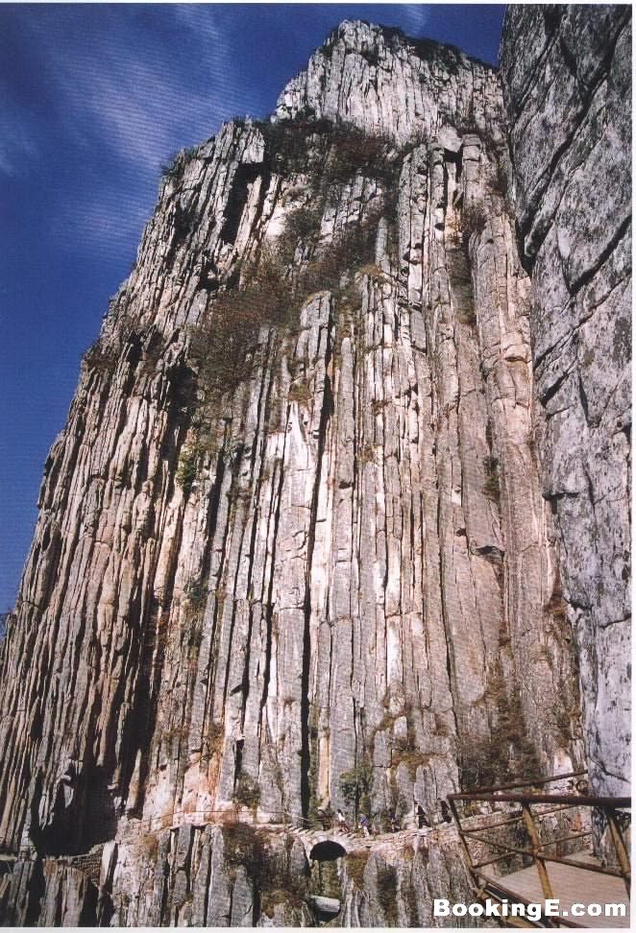
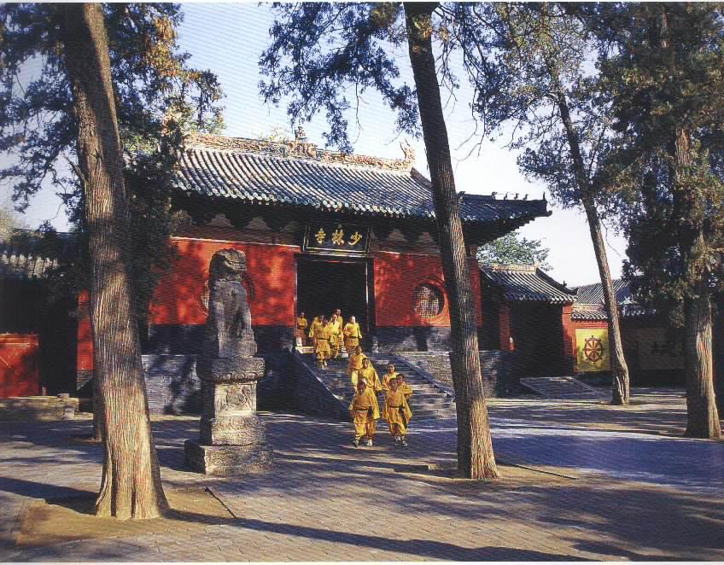
中岳 嵩山
Song Shan is one of the Five Sacred Mountains of Taoism and is located in He’nan province on the south bank of the Yellow River in China. Its summit is 1,500 meters above sea level. It is home to the Shaolin Temple, traditionally considered the birthplace of Zen Buddhism.

